Slide 1
Course details
Lecturer, schedule, project

Slide 2
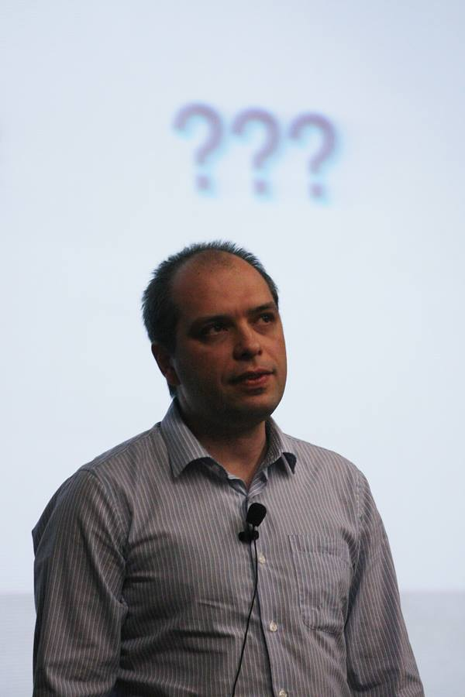
Who am I
Stamo Petkov
Information services Plc.
Microsoft Technologies department
s.g.petkov@is-bg.com
stamo.petkov@gmail.com
https://github.com/stamo
http://www.stamopetkov.eu
http://bg.linkedin.com/in/stamopetkov
https://www.facebook.com/stamo.petkov
@stamo_petkov

Slide 3
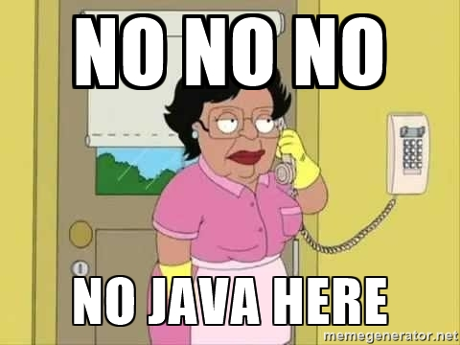
What will you learn
What is .NET
C# Basics
Asp .NET MVC
What’s next / Asp .NET Core
What about J2EE?

Slide 4

Short Agenda
15 lectures
4 lectures - C# basics
1 lecture - Test
9 lectures - Asp .NET MVC
1 lecture - Future of Asp .NET
1 Project

Slide 5

C# Basics
Introduction to .NET
.NET framework
Hello, C#
Visual studio
C# Basic concepts
Variables, operators, expressions
Conditional statements
if, if – else, nested if
switch
Loops
Loops in C#
Special loop operators

Slide 6

Test
On the 5th lecture
Online test
Questions on C# basics
2 – 3 homework – like problems
90 min.
1/4 of your mark

Slide 7
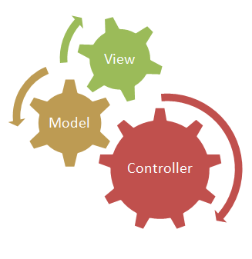
ASP .NET MVC
What is MVC
ASP .NET MVC Basics
Identity 2.0
Razor views
AJAX in ASP .NET MVC
Working with data
Advanced ASP .NET MVC

Slide 8

ASP .NET Core
Introduction to ASP .NET Core
What is Different in ASP.NET 5?
Rewritten, Flexible, Cross-Platform
Middlewares and IoC built-in
Identity 3.0
Tag Helpers
Web API in ASP.NET MVC Core
Entity Framework 7

Slide 9
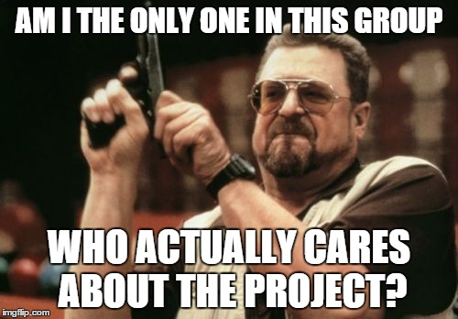
Project
ASP .NET MVC application
Configured Identity
Register / Login
Facebook / Google / Microsoft login
Two roles
Three controllers
Server and client side validation
Working with data
Partial view / loading with AJAX
½ of your mark

Slide 10

Any questions

